Slide 1
Intermediate Statistics
Lecture 9: Introduction to Causal Inference and Matching
March 20, 2025
HAD5772 • Alex Hoagland, Ph.D.
Notes:
Add slides on how to evaluate an RCT (simple example?)

Slide 2
Last Time
Linear regression (OLS, interpretation)
Selecting controls (dummy variables, interaction terms)
Transformations (log transformations, others)
This Time
How do we evaluate a regression?
What do we need for causal inference?
One example: propensity score matching

Slide 3
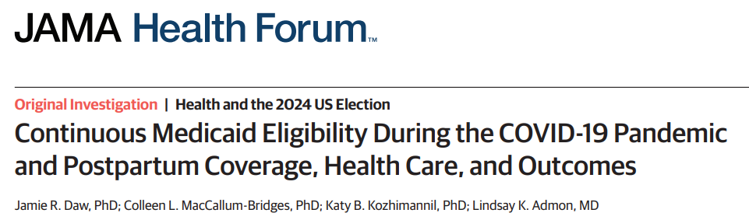
Case Study: Interpreting Regression
Context: during COVID-19, US expanded insurance coverage for low-income individuals (Medicaid) who were pregnant up to one year postpartum.
Research question: What were the effects of this policy on health outcomes?

Slide 4
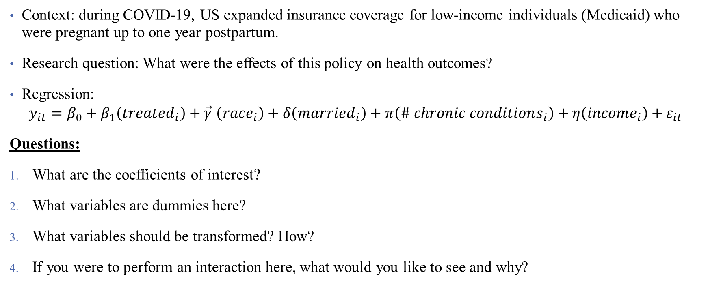
Case Study: Interpreting Regression
Context: during COVID-19, US expanded insurance coverage for low-income individuals (Medicaid) who were pregnant up to one year postpartum.
Research question: What were the effects of this policy on health outcomes?
Regression:
$$y_{it}=β_{0}+β_{1}\left(treated_{i}\right)+\vec{γ} \left(race_{i}\right)+δ\left(married_{i}\right)+π\left(\# chronic conditions_{i}\right)+η\left(income_{i}\right)+ε_{it}$$
Questions:
What are the coefficients of interest?
What variables are dummies here?
What variables should be transformed? How?
If you were to perform an interaction here, what would you like to see and why?

Slide 5
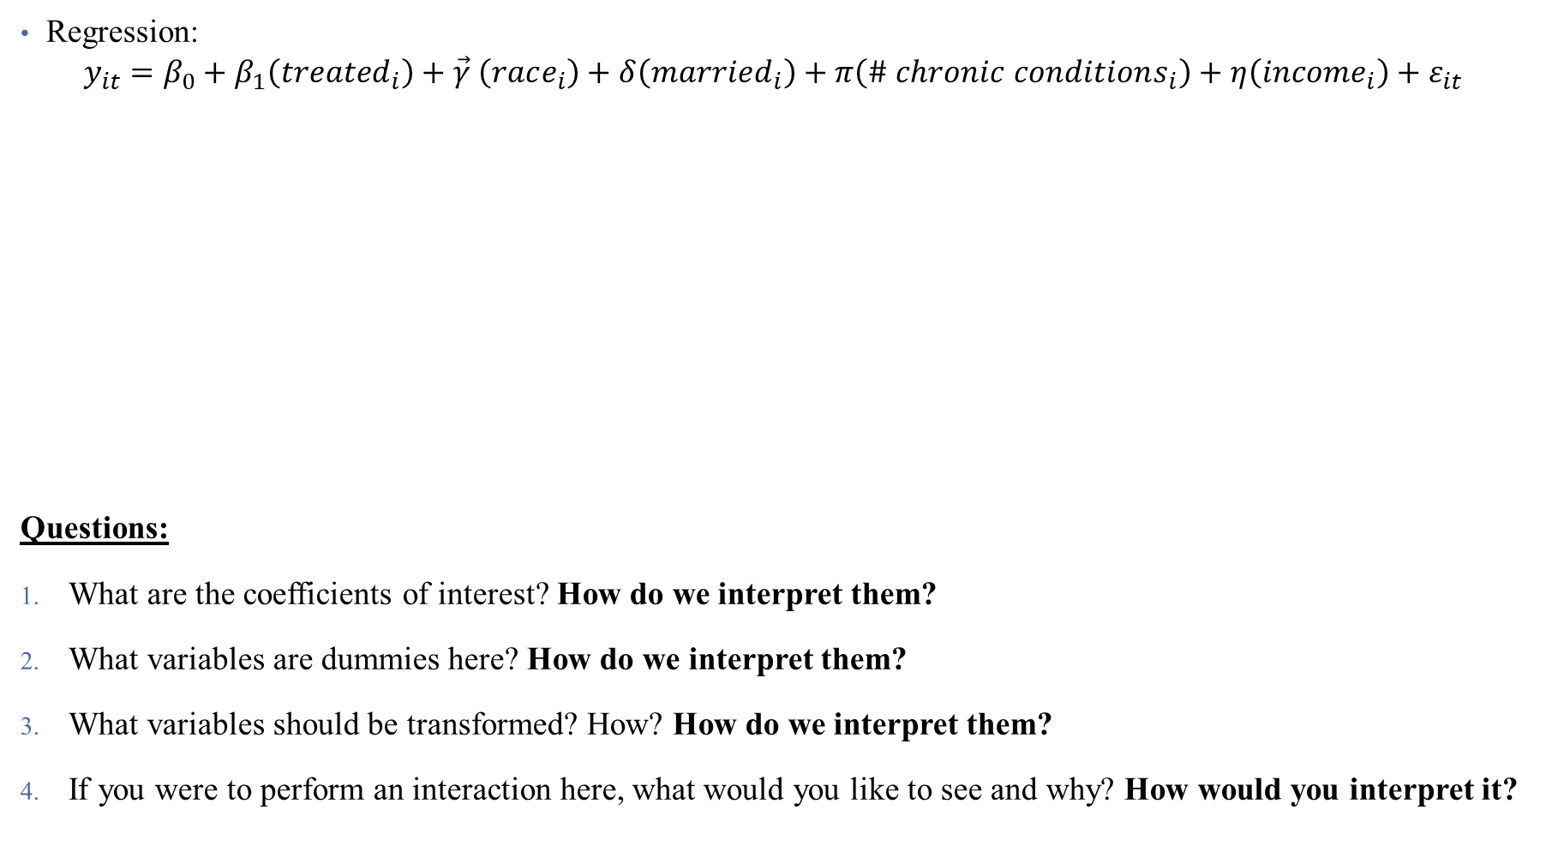
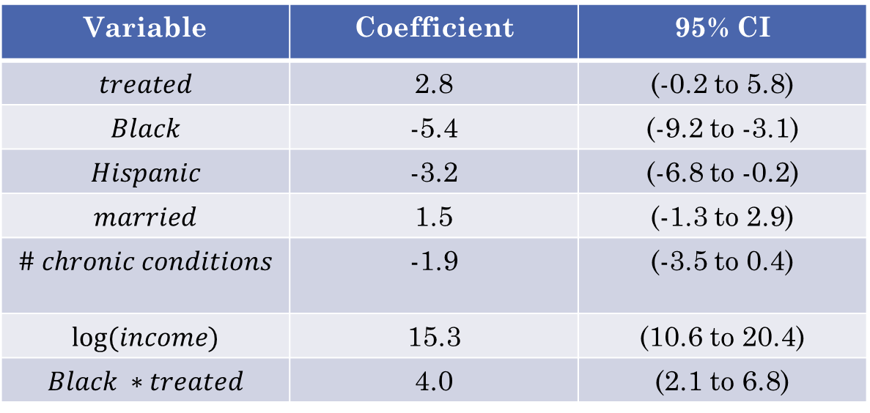
Case Study: Interpreting Regression
Regression:
$$y_{it}=β_{0}+β_{1}\left(treated_{i}\right)+\vec{γ} \left(race_{i}\right)+δ\left(married_{i}\right)+π\left(\# chronic conditions_{i}\right)+η\left(income_{i}\right)+ε_{it}$$
Questions:
What are the coefficients of interest? How do we interpret them?
What variables are dummies here? How do we interpret them?
What variables should be transformed? How? How do we interpret them?
If you were to perform an interaction here, what would you like to see and why? How would you interpret it?
Variable | Coefficient | 95% CI
$$treated$$ | 2.8 | (-0.2 to 5.8)
$$Black$$ | -5.4 | (-9.2 to -3.1)
$$Hispanic$$ | -3.2 | (-6.8 to -0.2)
$$married$$ | 1.5 | (-1.3 to 2.9)
$$\# chronic conditions$$ | -1.9 | (-3.5 to 0.4)
$$log⁡(income)$$ | 15.3 | (10.6 to 20.4)
$$Black ∗treated$$ | 4.0 | (2.1 to 6.8)
Notes:
Suppose the outcome is: likelihood of breastfeeding (in percentages). Note: some of this is made up.

Slide 6
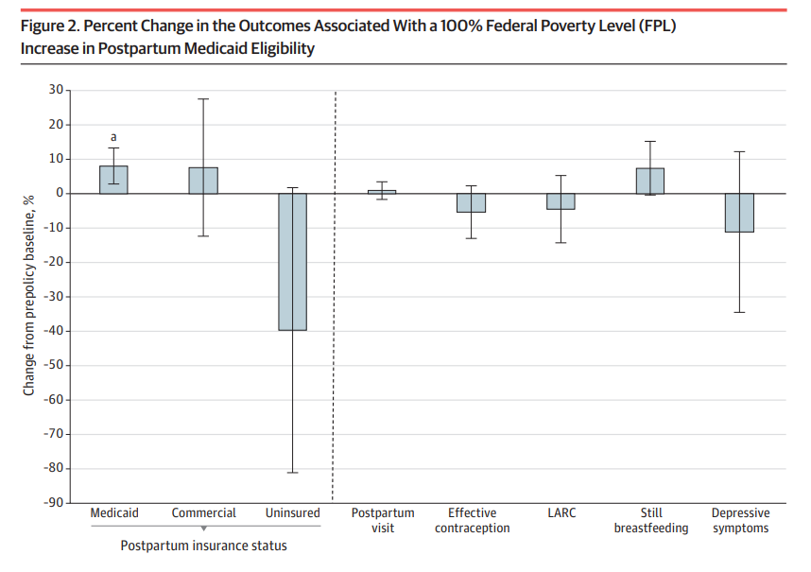
Case Study: Interpreting Regression
Notes:
What do we think about this visualization?

Slide 7
Types of Significance
What does significance mean in a regresion?
Something that isn’t significant isn’t wrong – just insignificant
Precise nulls are of research interest
A model should never be modified ex-post to obtain significant results!
One test is rarely sufficient to come to a conclusion
This is why economics papers are typically 50+ pages plus appendix
Notes:
New thing to hit here: economic versus statistical significance – a p-value is all well and good, but what is the takeaway? What’s the story?

Slide 8
Types of Significance
What does significance mean?
Something that isn’t significant isn’t wrong – just insignificant
Precise nulls are of research interest
A model should never be modified ex-post to obtain significant results!
One test is rarely sufficient to come to a conclusion
This is why economics papers are typically 50+ pages plus appendix
Difference between statistical significance and economic significance
What does your result mean?
What does it mean to be statistically significant in this context?
What does the estimated coefficient imply about policy? Welfare? Etc.?
Notes:
New thing to hit here: economic versus statistical significance – a p-value is all well and good, but what is the takeaway? What’s the story?

Slide 9
What do my results mean?
Types of causal validity
Notes:
We’re gonna talk about some types of “regression validity” – not R-squared but when the link between regression and model is strong enough. Suppose that our goal is to estimate the association between some things and quality of care in a hospital. What are some possible variables to include? (Exercise for discussion). Then talk about taking this to data – how do we measure everything?

Slide 10

What do my results mean?
Types of causal validity
Construct validity: are we measuring what we want to measure?
How is the outcome variable measured?
Are we capturing the right spot in the distribution (mean, median, etc.?)
Notes:
Story: A policewoman sees a man searching for something under a streetlight and asks what the man has lost. He says he lost his keys, and they both look under the streetlight together. After a few minutes, the policewoman asks the man if he is sure he lost them here, and he replies, no, and that he lost them in the park. The policewoman asks why he is searching here, and the man replies, “This is where the light is."
This is also known as the street light effect – researchers shine the light just on the street, miss what’s to the side. Are you asking the right questions? An example: a program hopes to improve commitment to school, and boasts that it improves test scores -- does that measure the outcome you want (teacher performance, kid happiness, etc.?) or does it just measure how good kids are at taking tests. Data limitations play a big role here (in health, think quality measurements, or metrics of risk/equity/etc.)

Slide 11
What do my results mean?
Types of causal validity
Construct validity: are we measuring what we want to measure?
Statistical validity: are your statistics correct?
Do you have enough statistical power to get the results that you want?
Are all of your required assumptions met?
Was there any p-hacking involved in getting the answer you published?
Are your associations causal or spurious correlation?
Notes:
These are questions that are nearly impossible to answer in a paper or project (okay, you can do a power calculation – ish). But you still need to think carefully about each of these.

Slide 12
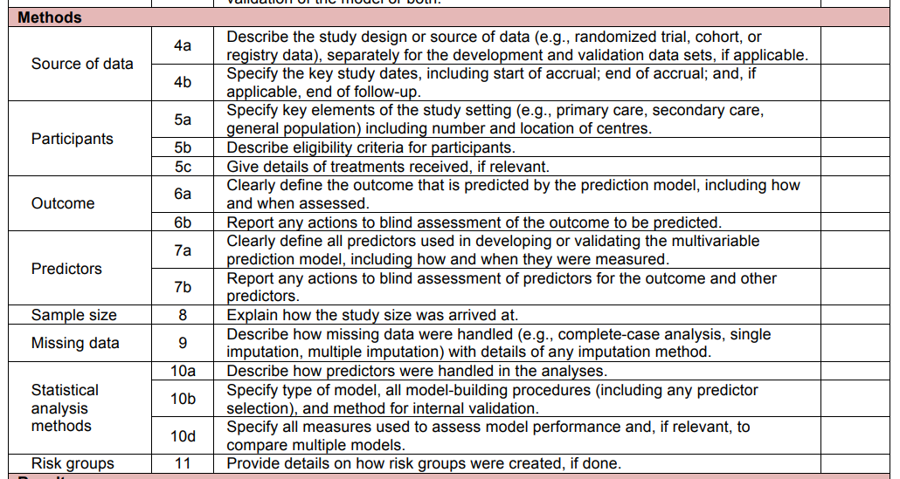
How do I report my results and assumptions?
The TRIPOD Checklist has useful structure on what you should be watching out for
Notes:
Also includes things like – what limitations should be noted, what should go in a discussion, etc. We’ll try to talk more about this with each method we cover.

Slide 13
What do my results mean?
Types of causal validity
Construct validity: are we measuring what we want to measure?
Statistical validity: are your statistics correct?
Internal validity: are your mechanisms correct?
Did you pick up the causal pathway you wanted?
Lots of threats!
Selection, omitted variable bias, attrition, seasonality, measurement error, spillovers
Each of these can affect your results
Notes:
Economists call internal validity “identification” You might not even have seen all the threats if your DAG is incomplete or wrong. A good econometrician is trained to try to pick at all the potential threats to identification / internal validity here. The best way to get around these is to think about as many as you can and then present your work as much as you can – people will help you see what you’re missing.

Slide 14
What do my results mean?
Types of causal validity
Construct validity: are we measuring what we want to measure?
Statistical validity: are your statistics correct?
Internal validity: are your mechanisms correct?
External validity: are your findings generalizable?
Are your results a fluke of a limited sample?
Notes:
We’ll talk about more threats to internal validity throughout the course, particularly next time. If you want to think about multiple threats to IV, just think about nutrition research (they’re everywhere!). What’s an example of selection bias in our context?

Slide 15
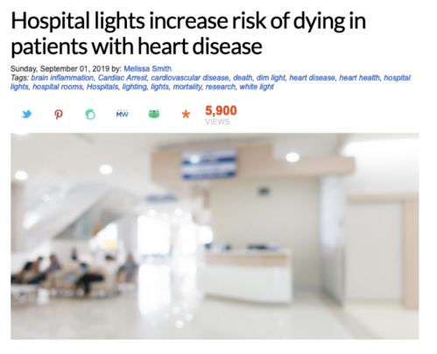
Example of External Validity
Notes:
Um what? Don’t trust the headlines, or the lay media.

Slide 16
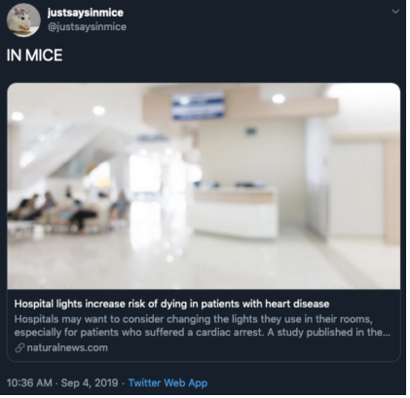
Example of Selection Bias: Marriage and Happiness
Notes:
True story: this was a study published about mice! But read the text summarizing the study.

Slide 17
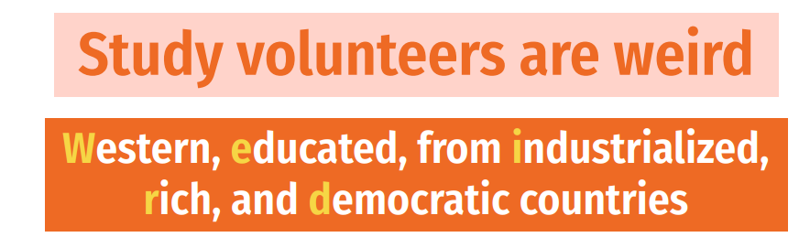
What do my results mean?
Types of causal validity
Construct validity: are we measuring what we want to measure?
Statistical validity: are your statistics correct?
Internal validity: are your mechanisms correct?
External validity: are your findings generalizable?
Are your results a fluke of a limited sample?
Does your data match the population?
Notes:
Particularly of concern with surveys or even clinical trials

Slide 18
Notes on Causality and Bias

Slide 19
Interpreting your results causally (One more time)
Remember that causality is hard!
Even after specifying your model, other things could go wrong:
Omitted Variables: missing data can bias your estimates
Measurement Error: mismeasured data can bias your estimates
Collinearity: correlation between variables can limit inferences
Notes:
We’re gonna touch on more threats to internal validity now.

Slide 20
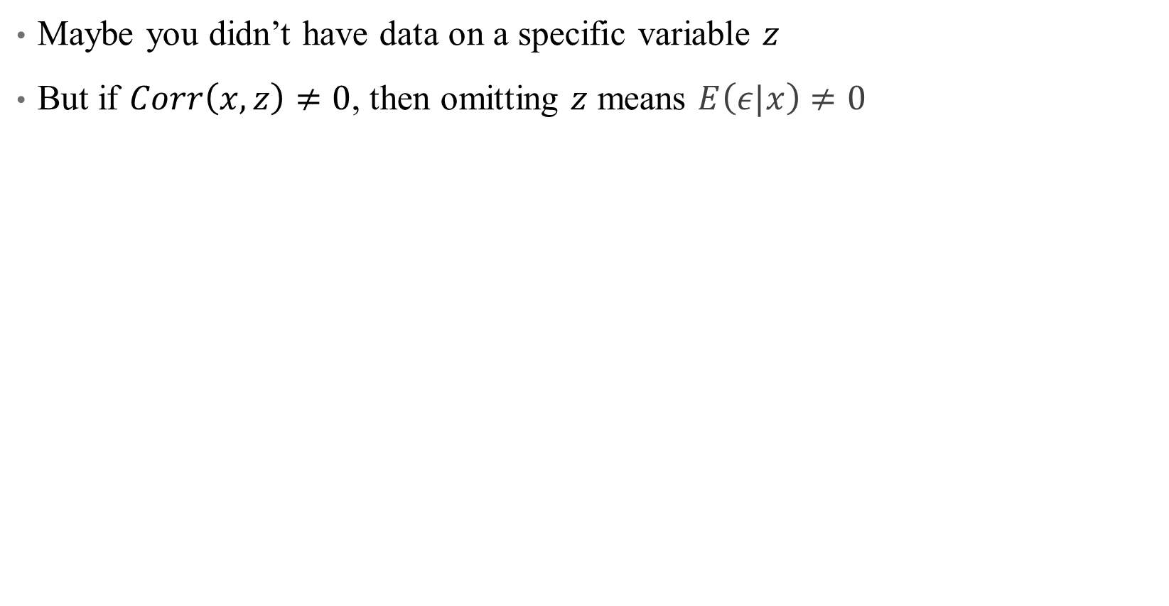
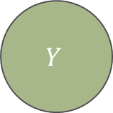
Omitted Variables
Maybe you didn’t have data on a specific variable $z$
But if $Corr\left(x,z\right)≠0$, then omitting $z$ means $E\left(ε|x\right)≠0$
X
D
$$Y$$
R
Notes:
Leaving a back door open is a big problem in design-based inference. We’ve talked about this a lot, let’s look at some math real quick.

Slide 21

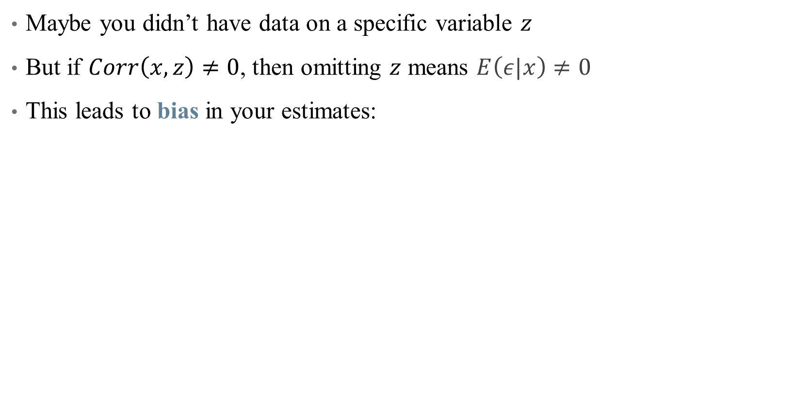
Omitted Variables
Maybe you didn’t have data on a specific variable $z$
But if $Corr\left(x,z\right)≠0$, then omitting $z$ means $E\left(ε|x\right)≠0$
This leads to bias in your estimates:
$$bias\left(\hat{β_{1}}\right)=𝔼\left[\hat{β_{1}}\right]−β_{1}$$
$$=Corr\left(x,z\right)\frac{σ_{ε}}{σ_{x}}$$

Slide 22
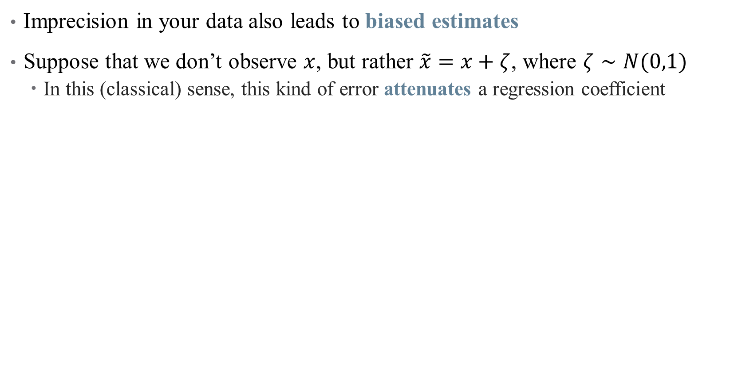
Measurement Error
Imprecision in your data also leads to biased estimates
Suppose that we don’t observe $x$, but rather $\tilde{x}=x+ζ$, where $ζ∼N(0,1)$
In this (classical) sense, this kind of error attenuates a regression coefficient
Notes:
Attenuation is a common refrain in published papers, but measurement error is more complicated than that!

Slide 23
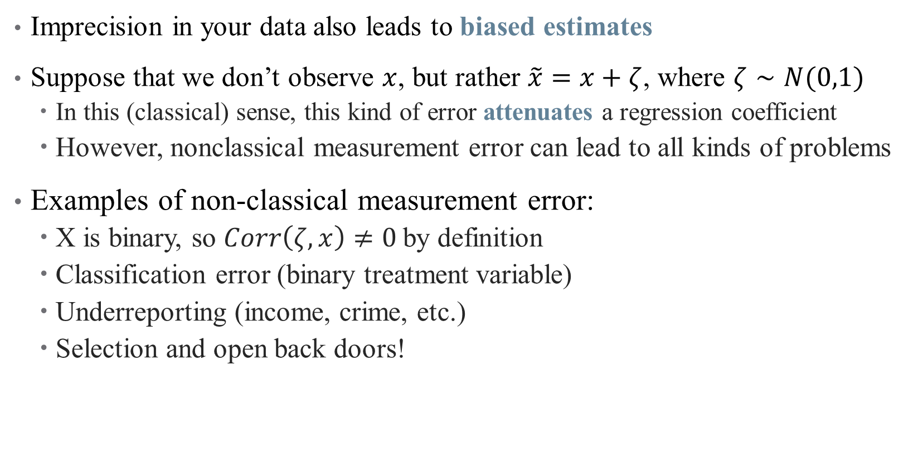
Measurement Error
Imprecision in your data also leads to biased estimates
Suppose that we don’t observe $x$, but rather $\tilde{x}=x+ζ$, where $ζ∼N(0,1)$
In this (classical) sense, this kind of error attenuates a regression coefficient
However, nonclassical measurement error can lead to all kinds of problems
Examples of non-classical measurement error:
X is binary, so $Corr\left(ζ, x\right)≠0$by definition
Classification error (binary treatment variable)
Underreporting (income, crime, etc.)
Selection and open back doors!
Notes:
Examples: are we actually measuring quality appropriately?

Slide 24
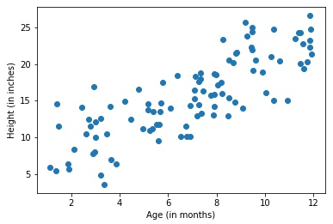
Collinearity and Causality
Some (explanatory) variables are highly correlated, complicating inference
Notes:
If I include age and height in a regression to close back doors, how do I know what is explained by age and what is explained by height? Here, this might not matter (we just care about “growth” as the causal pathway) but what if we could consider a policy that would randomly make people taller. Would that help health? Shrugh

Slide 25
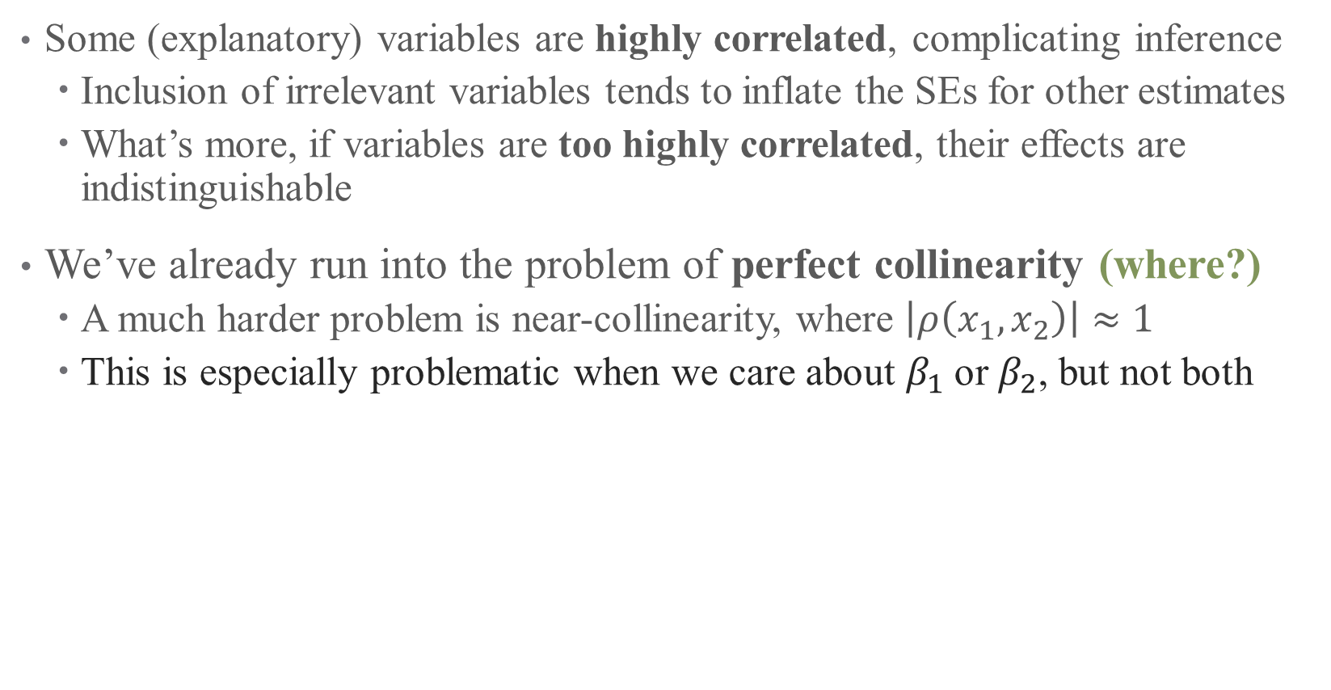
Collinearity and Causality
Some (explanatory) variables are highly correlated, complicating inference
Inclusion of irrelevant variables tends to inflate the SEs for other estimates
What’s more, if variables are too highly correlated, their effects are indistinguishable
We’ve already run into the problem of perfect collinearity (where?)
A much harder problem is near-collinearity, where $\left|ρ\left(x_{1},x_{2}\right)\right|≈1$
This is especially problematic when we care about $β_{1}$or $β_{2}$, but not both
Notes:
Where have we seen perfect collinearity? Dummy variable trap?

Slide 26
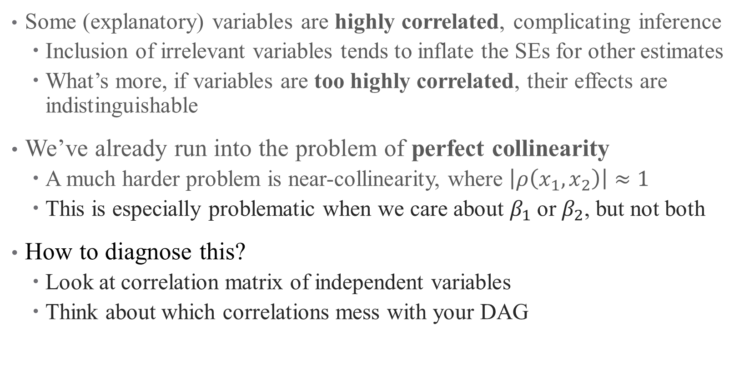
Collinearity and Causality
Some (explanatory) variables are highly correlated, complicating inference
Inclusion of irrelevant variables tends to inflate the SEs for other estimates
What’s more, if variables are too highly correlated, their effects are indistinguishable
We’ve already run into the problem of perfect collinearity
A much harder problem is near-collinearity, where $\left|ρ\left(x_{1},x_{2}\right)\right|≈1$
This is especially problematic when we care about $β_{1}$or $β_{2}$, but not both
How to diagnose this?
Look at correlation matrix of independent variables
Think about which correlations mess with your DAG
Notes:
Think about how much it really matters – collinearity is a problem if it messes with the causal parameter of interest, but doesn’t matter if age and height are both controls.

Slide 27
Causal Inference Frameworks

Slide 28
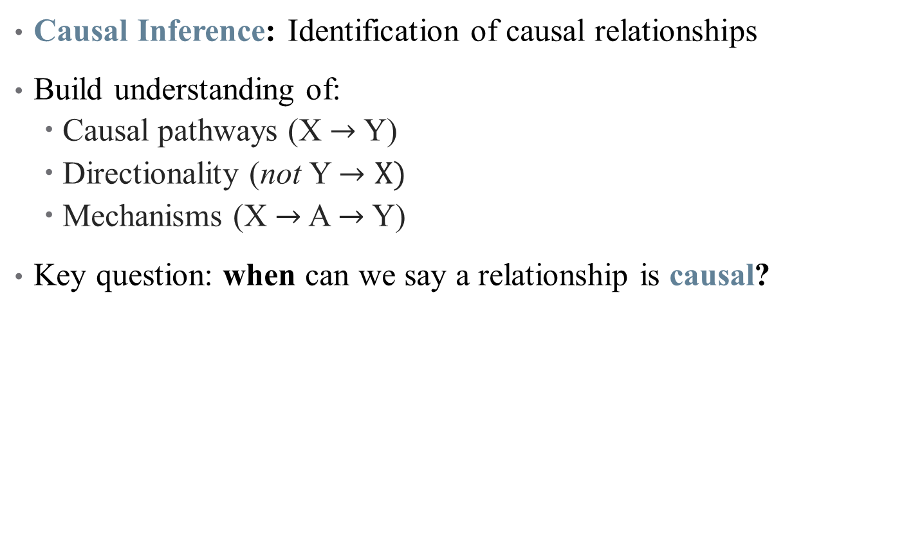
Goal of Econometric Analysis
Causal Inference: Identification of causal relationships
Build understanding of:
Causal pathways (X $→$ Y)
Directionality (not Y $→X)$
Mechanisms (X $→$ A $→$ Y)
Key question: when can we say a relationship is causal?
Notes:
Our goal is to understand a DGP – what gives rise to the data we see in the world? Stick with example: when can we say moving to a hospital of different quality has a *causal* effect on patient outcomes? Think about an ideal experiment there (first RCT), then a quasi-experiment (hospital closures, patient moving)

Slide 29
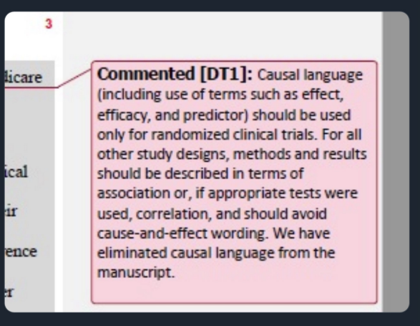
All that glitters is an RCT?
Can we only believe randomized control trials?
Notes:
But gold standard has been taken over by medical journals in particular. What would an RCT be in our standard?

Slide 30
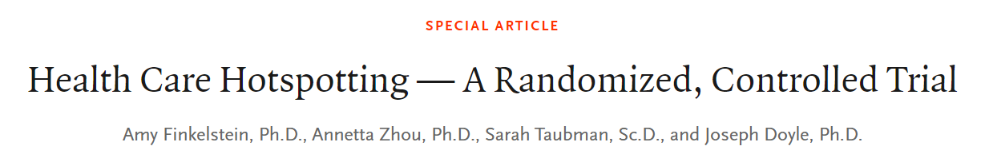
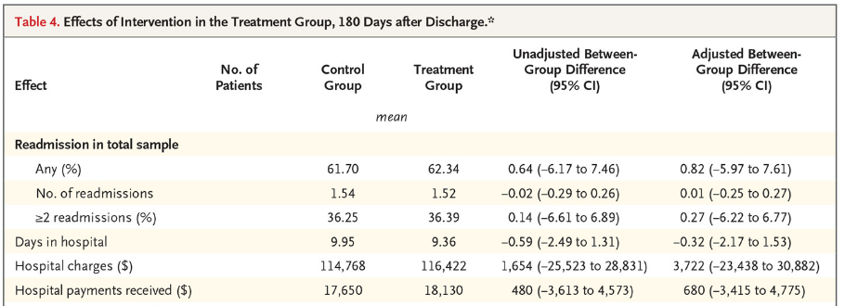
All that glitters is an RCT?
How do we interpret an RCT? Analysis is easy!
Notes:
Example: We randomly assigned 800 hospitalized patients with medically and socially complex conditions, all with at least one additional hospitalization in the preceding 6 months, to the Coalition’s care-transition program or to usual care. The primary outcome was hospital readmission within 180 days after discharge.

Slide 31
All that glitters is an RCT?
Can we only believe randomized control trials?
RCTs are useful in some settings, but what are some problems with them?
Notes:
Gol standard of med research is RCT – is that all we can use?

Slide 32
All that glitters is an RCT?
Can we only believe randomized control trials?
RCTs are useful in some settings, but what are some problems with them?
Not always feasible
Implicit biases
Can’t always detect negative side effects
Problems with external validity, scaling, etc.
Econometric analysis helps identify real world patterns from real world data
Notes:
Decades of research goes into understanding how real data can give us (some) real answers. There are more assumptions and some limits on the parameters you return, but that’s a tradeoff worth taking.

Slide 33
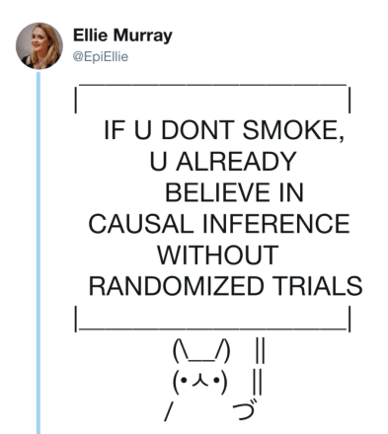
All that glitters is an RCT?
Notes:
Policies are not all based on RCTs -- many rely on real-world data and causal inference. The questions are: (1) is that causal inference sound? And (2) more philosophically – to what extent should all policy be built on evidence vs. art/craft/intuition? Do we need more evidence about drinking age, for example?

Slide 34
Econometric approach
Observational data: retrospective, “real-world” data
Not (typically) collected in a lab setting
Surveys, claims, tax records, etc.
What created that data?
Data Generating Process: what unique collection of characteristics, events, and randomness coalesced to form the data we are looking at?
Our objective is to use the data available to try and establish the nature of the true DGP.
But many different DGPs are possible, and many may yield very similar patterns!
Notes:
Example: Go back to evaluating quality of care on patient outcomes. What real-world things mimic an RCT? Hospital closures, patients moving, etc.

Slide 35
DGPs as DAGs
Directed Acyclic Graphs (DAGs):
Graphical relationship of a chain of causal effects
Represented as random variables (nodes) and influencing events (arrows)
Maps a philosophical model
D
Y
X
Notes:
Note: there’s no math behind the causal structure – that’s all the hypothesis part of the scientific method. Why acyclic – no simultaneity (no cycles in the graph)

Slide 36
DGPs as DAGs
Directed Acyclic Graphs (DAGs):
Graphical relationship of a chain of causal effects
Represented as random variables (nodes) and influencing events (arrows)
Maps a philosophical model
Example: Improving Physician Quality
Y: Outcome of interest (Level of care)
D: Treatment (Information about cost-effective treatment)
X: Covariates (MD demographics, region, specialty)
Why would X contribute to D?
D
Y
X

Slide 37
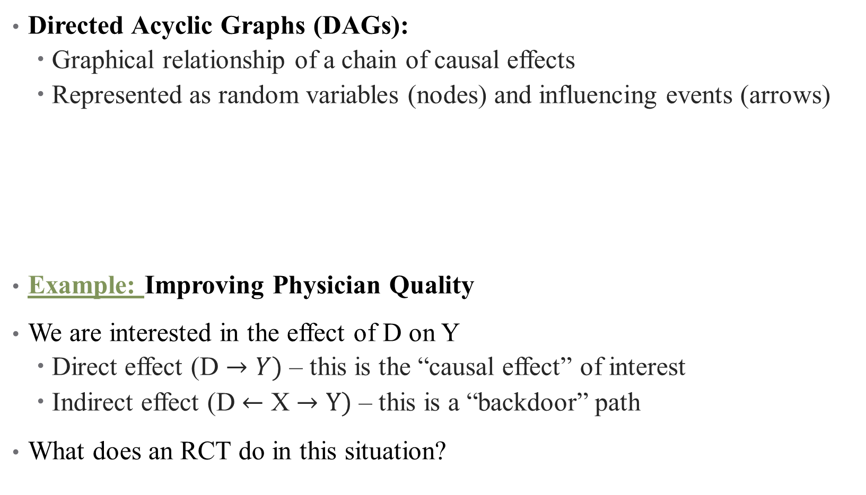
DGPs as DAGs
Directed Acyclic Graphs (DAGs):
Graphical relationship of a chain of causal effects
Represented as random variables (nodes) and influencing events (arrows)
Example: Improving Physician Quality
We are interested in the effect of D on Y
Direct effect (D $→Y)$ – this is the “causal effect” of interest
Indirect effect (D $←$ X $→Y)$ – this is a “backdoor” path
What does an RCT do in this situation?
D
Y
X
Notes:
An RCT, in this situation, would eliminate (“close”) effect of X on Y by randomizing (so that there is no “X \rightarrow D”)

Slide 38
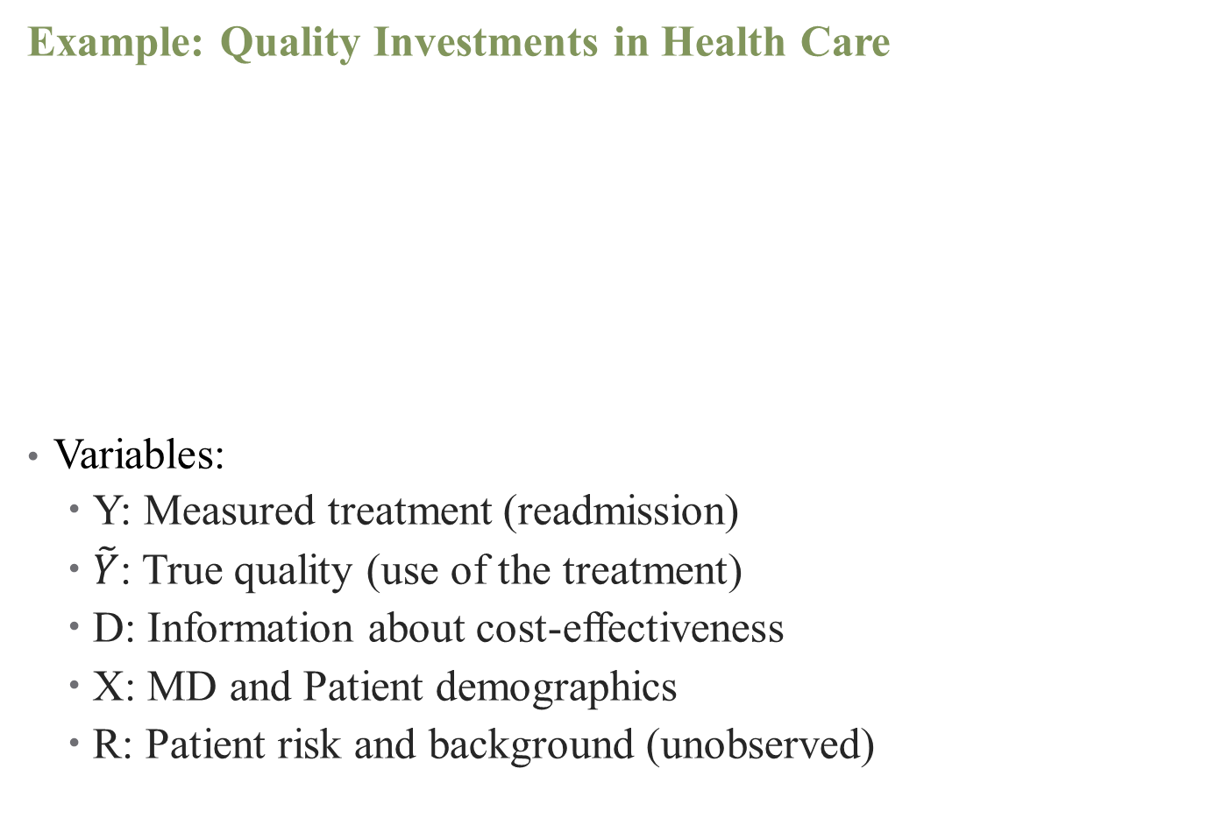

A More Involved DAG
Example: Quality Investments in Health Care
Variables:
Y: Measured treatment (readmission)
$\tilde{Y}$: True quality (use of the treatment)
D: Information about cost-effectiveness
X: MD and Patient demographics
R: Patient risk and background (unobserved)
X
D
$$\tilde{Y}$$
Y
R
Notes:
Types of relationships: (1) chain X -> y -> z; (2) fork z <- x -> y; (3) inverted fork / collider z -> x <- y (x is the collider; controlling for it can cause a spurious relationship between any of the three variables)

Slide 39
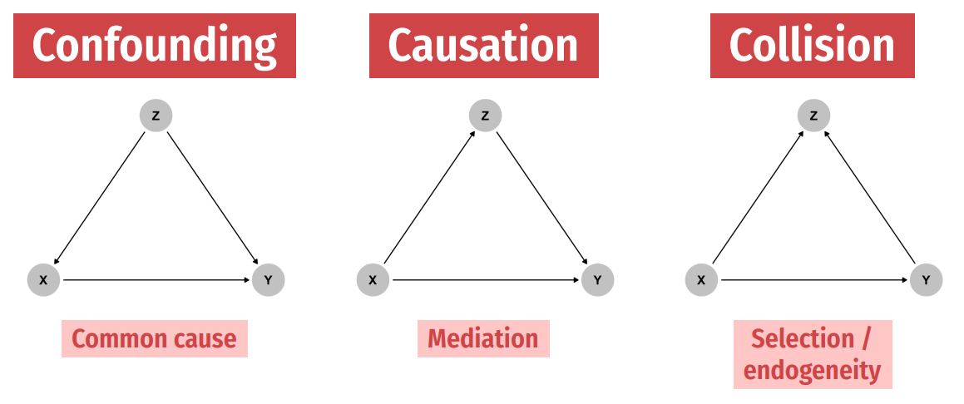
Associations in DAGs
Notes:
DAGs give names and structures to types of obstacles to causal inference. Examples: confounding was just done. Can you think of others? (Mediation is like effect of education on salary, by race; collision is like admission rate bias – you might discover spurious correlations between diseases if you have a selected sample of hospitalized patients, such as between respiratory disease and locomotor disease) We’ll talk about these all more in class.

Slide 40
Associations in DAGs
Notes:
DAGs give names and structures to types of obstacles to causal inference. Examples: confounding was just done. Can you think of others? (Mediation is like effect of education on salary, by race; collision is like admission rate bias – you might discover spurious correlations between diseases if you have a selected sample of hospitalized patients, such as between respiratory disease and locomotor disease) We’ll talk about these all more in class.

Slide 41
Associations in DAGs
Notes:
DAGs give names and structures to types of obstacles to causal inference. Examples: confounding was just done. Can you think of others? (Mediation is like effect of education on salary, by race; collision is like admission rate bias – you might discover spurious correlations between diseases if you have a selected sample of hospitalized patients, such as between respiratory disease and locomotor disease) We’ll talk about these all more in class.

Slide 42
Some Drawbacks of DAGs
Causality runs in one direction (simultaneity and reverse causality usually better represented with potential outcomes framework)
Where does the DAG come from?
How could this DAG be more complicated?
For help drawing DAGs in R, see https://evalf22.classes.andrewheiss.com/example/dags.html
X
D
$$\tilde{Y}$$
Y
R
Notes:
DAG is a theoretical, hypothesized object.

Slide 43
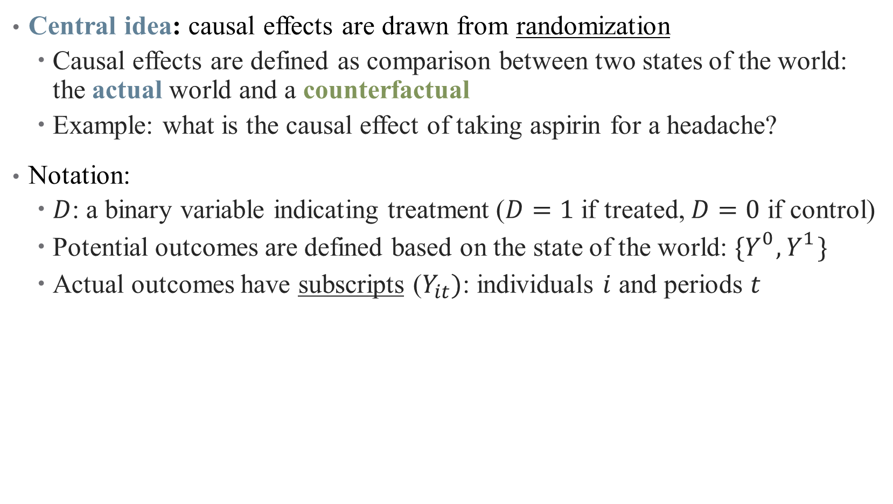
Another approach: Potential Outcomes
Central idea: causal effects are drawn from randomization
Causal effects are defined as comparison between two states of the world: the actual world and a counterfactual
Example: what is the causal effect of taking aspirin for a headache?
Notation:
$D$: a binary variable indicating treatment ($D=1$ if treated, $D=0$ if control)
Potential outcomes are defined based on the state of the world: ${\{Y}_{}^{0},Y_{}^{1}\}$
Actual outcomes have subscripts ($Y_{it})$: individuals $i$ and periods $t$
Notes:
Superscripts versus subscripts

Slide 44
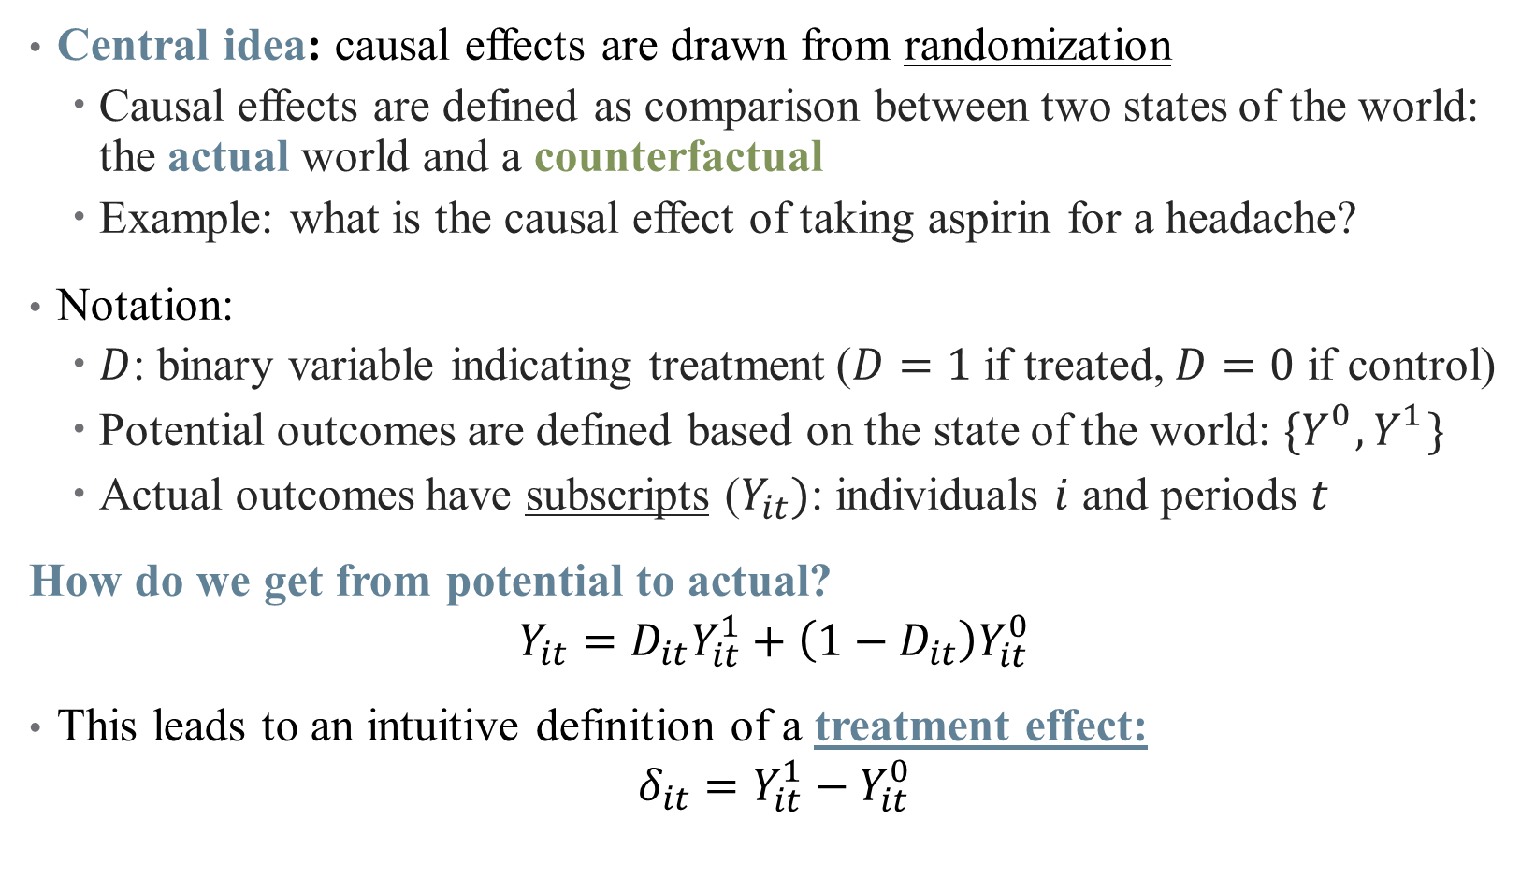
Another approach: Potential Outcomes
Central idea: causal effects are drawn from randomization
Causal effects are defined as comparison between two states of the world: the actual world and a counterfactual
Example: what is the causal effect of taking aspirin for a headache?
Notation:
$D$: binary variable indicating treatment ($D=1$ if treated, $D=0$ if control)
Potential outcomes are defined based on the state of the world: ${\{Y}_{}^{0},Y_{}^{1}\}$
Actual outcomes have subscripts ($Y_{it})$: individuals $i$ and periods $t$
How do we get from potential to actual?
$$Y_{it}=D_{it}Y_{it}^{1}+\left(1−D_{it}\right)Y_{it}^{0}$$
This leads to an intuitive definition of a treatment effect:
$$δ_{it}=Y_{it}^{1}−Y_{it}^{0}$$
Notes:
What’s the central problem here? For each individual, we only observe 1 or the other! This is the fundamental problem of causal inference

Slide 45
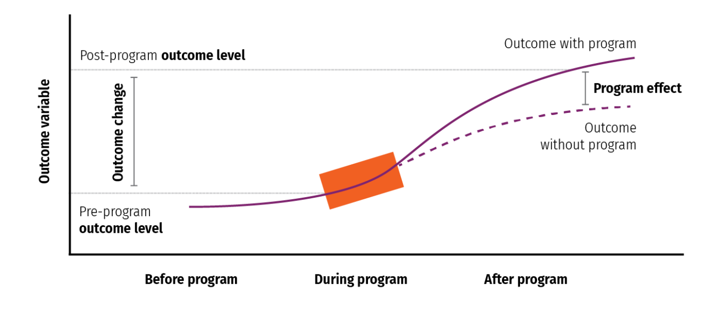
Another approach: Potential Outcomes
Notes:
If we observed both outcomes for an individual, calculating the ATE (parameter of interest) would be easy (like in It’s a Wonderful Life)

Slide 46
Propensity Score Matching

Slide 47
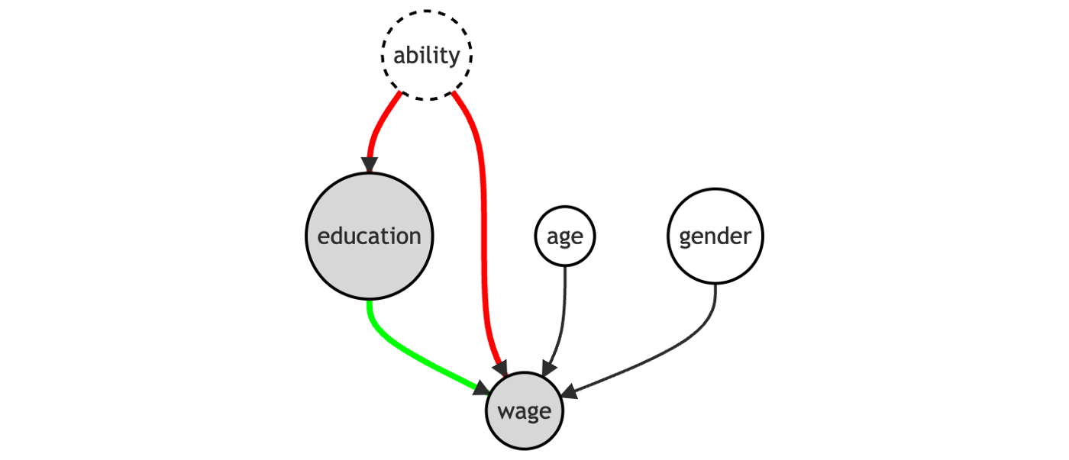
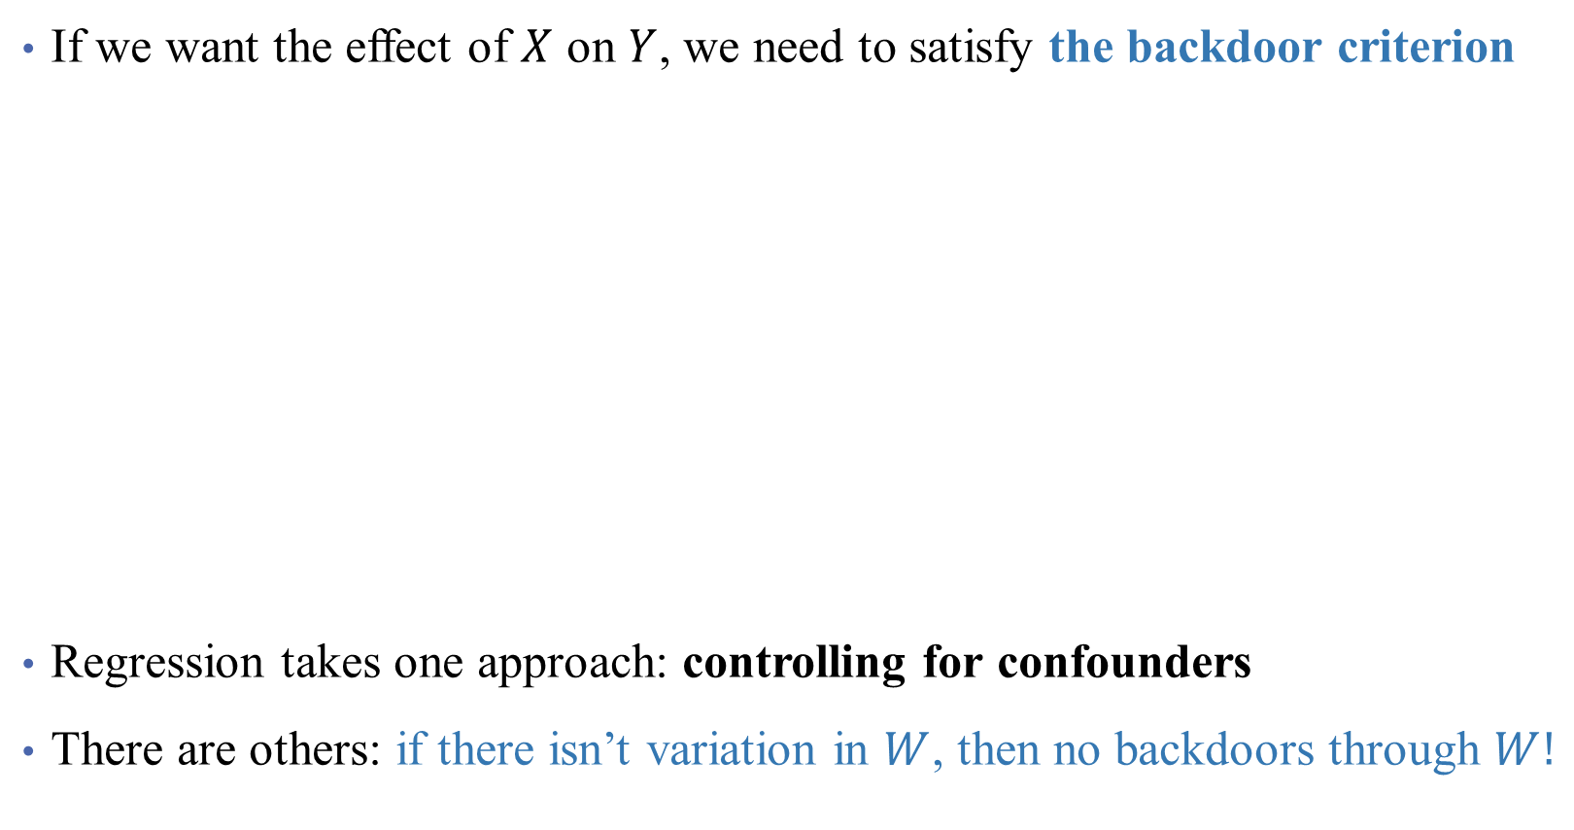
Causal Inference: Satisfying the Backdoor Criterion
If we want the effect of $X$ on $Y$, we need to satisfy the backdoor criterion
Regression takes one approach: controlling for confounders
There are others: if there isn’t variation in $W$, then no backdoors through $W!$
Notes:
Draw this DAG on the whiteboard – erase links between ability and education (removes omitted variable bias)

Slide 48
Causal Inference: Satisfying the Backdoor Criterion
If we want the effect of $X$ on $Y$, we need to satisfy the backdoor criterion
Regression takes one approach: controlling for confounders
Key for today: if there isn’t variation in $W$, then no backdoors through $W!$
Conditional Independence Assumption: treatment is conditionally random
Notes:
Here, conditionally random is conditional on regression controls, but on matching.

Slide 49

Causal Inference: Satisfying the Backdoor Criterion
If we want the effect of $X$ on $Y$, we need to satisfy the backdoor criterion
Key for today: if there isn’t variation in $W$, then no backdoors through $W!$
Notes:
This is the magic of randomization! It’s what makes an RCT so powerful – here, we will approximate it (design-based inference) by selecting a subset of our data where individuals look similar (including in ability), but where treatment is quasi-randomly assigned. Same idea behind approximating an experiment in our context.

Slide 50
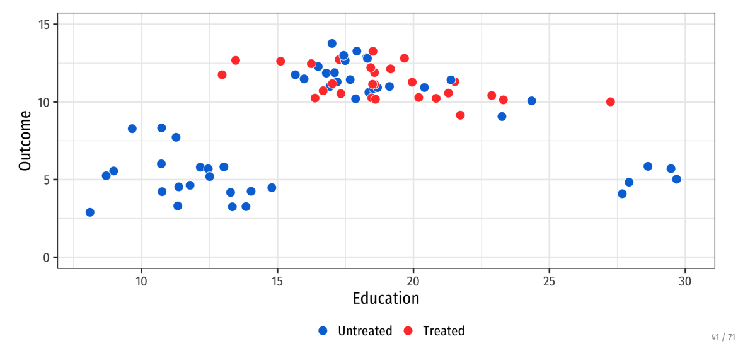
Matching reduces model dependence
Notes:
Why is just controlling for education here not enough? You still have untreated observations that look basically nothing like the treated observations, and they’re still being included in the regression. Maybe they shouldn’t be?
So suppose you want to compare how a heart attack affects a family – if you just throw in controls for age/sex/risk/etc., you’re still using data on the triathlon runners against the heart attack families.
Reducing model dependence means that researcher discretion is limited – you’re really comparing apples to apples. Suppose we have this data and want a treatment effect

Slide 51
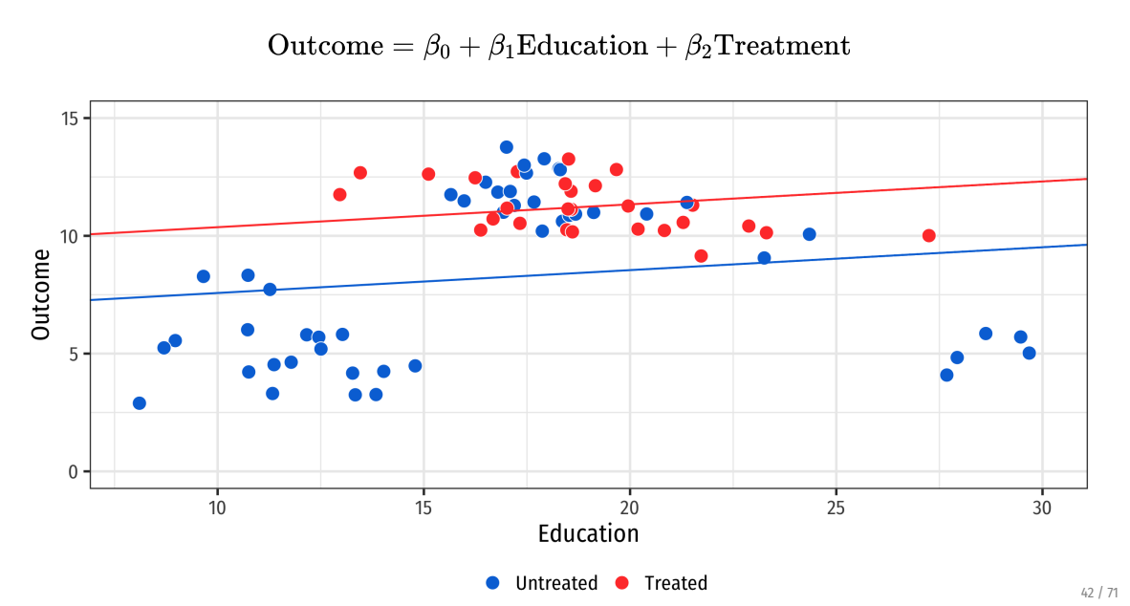
Matching reduces model dependence
Notes:
This is what happens if you pool all data. We can try either a linear regression (what’s the treatment effect)

Slide 52
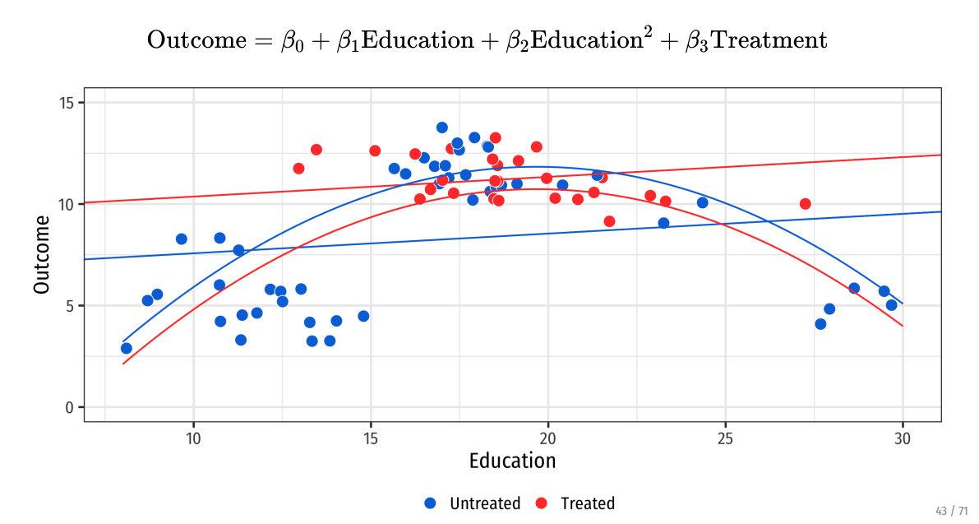
Matching reduces model dependence
Notes:
Or we try a quadratic fit – now the ATE is flipped? Which is correct?
Can anyone see what the problem is (we have untreated outliers that are skewing regressions – we don’t want these observations because they aren’t comparable to treated group)

Slide 53
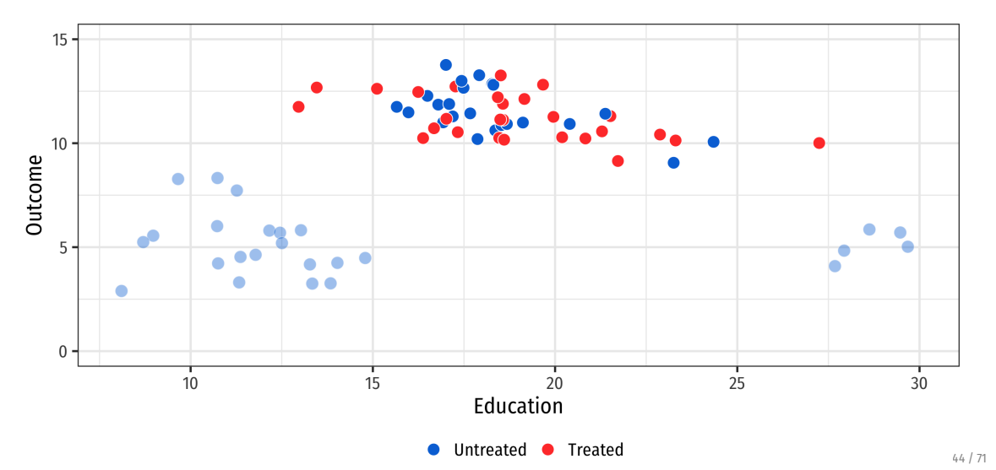
Matching reduces model dependence
Notes:
So drop these observations – now line and quadratic tell similar stories

Slide 54
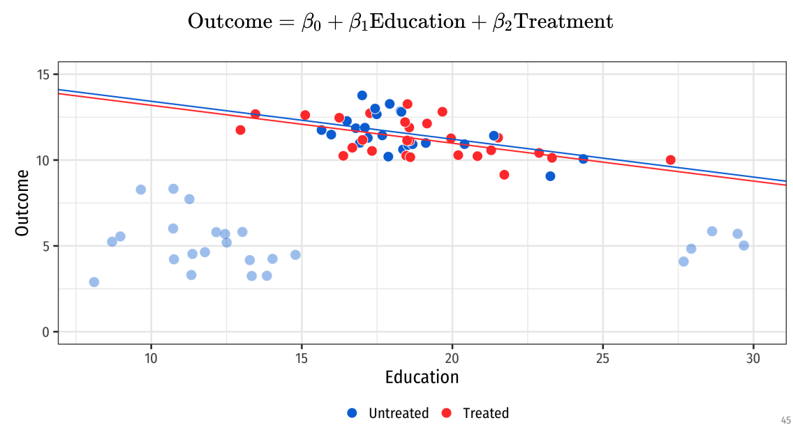
Matching reduces model dependence
Notes:
So drop these observations – now line and quadratic tell similar stories

Slide 55
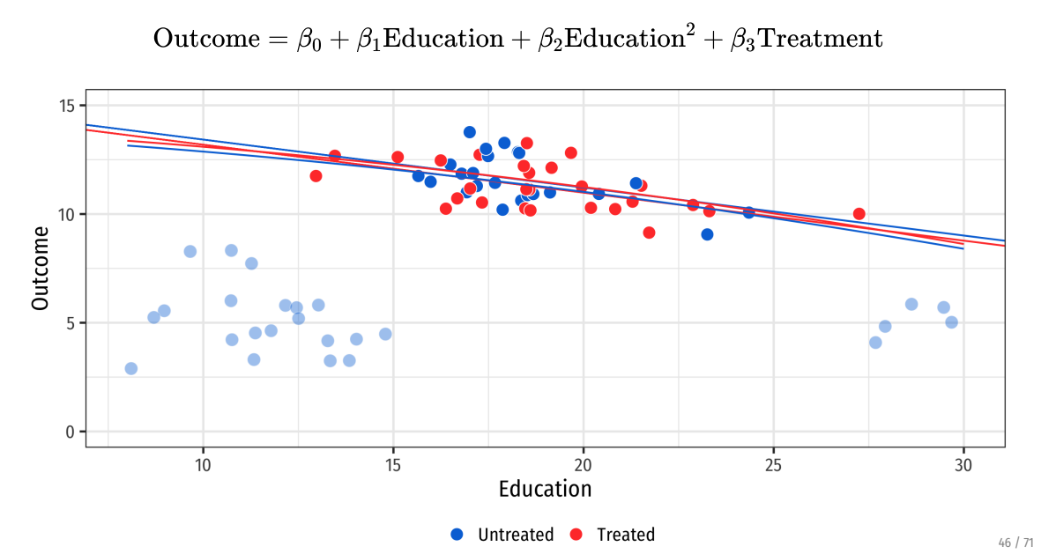
Matching reduces model dependence
Notes:
Without need to fit the poorly matching observations, models tell a story that reflects the data we care about. (That’s the kicker philosophically here – is there data we can say we “care more about”)?

Slide 56
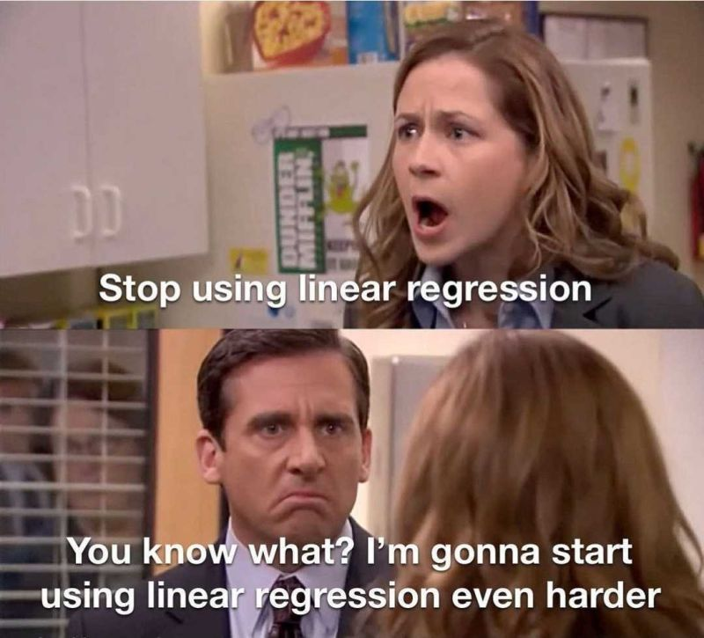
Matching combines well with regression!
Notes:
Really, it’s not matching or regression – it’s matching + regression! Appropriate data selection + model selection can be your friend.

Slide 57
Example: Infertility Treatment and Risks of Severe Maternal Morbidity
Notes:
Start with: what did you like about the paper? What was confusing for you?

Slide 58
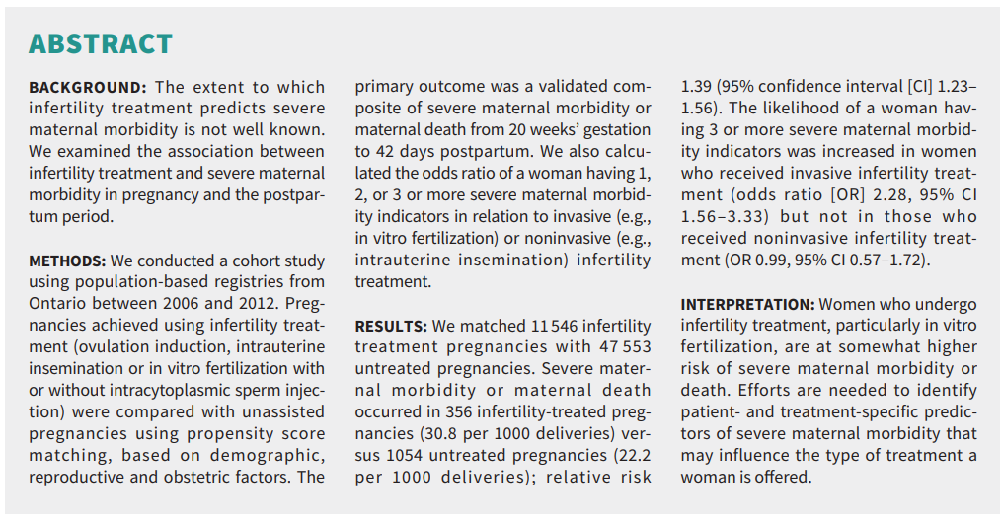
Matching combines well with regression!
Notes:
Note: still using association. Why? What might be imperfect about matching?
Discussion questions:
What is the importance of this question? (Infertility affects 1 in 6, treatment affects up to 4% of births in Canada). Are there risks?
What are the outcomes? What is the independent and dependent variable here? How are they defined? (SMM includes near-fatal events from eclampsia, etc. Why near-fatal? Mortality is too low to look at carefully).
Why can’t we do an RCT here?
What is the comparison without matching? What are the open back doors we need to close? (main problem: selection into IVF and *age*)

Slide 59
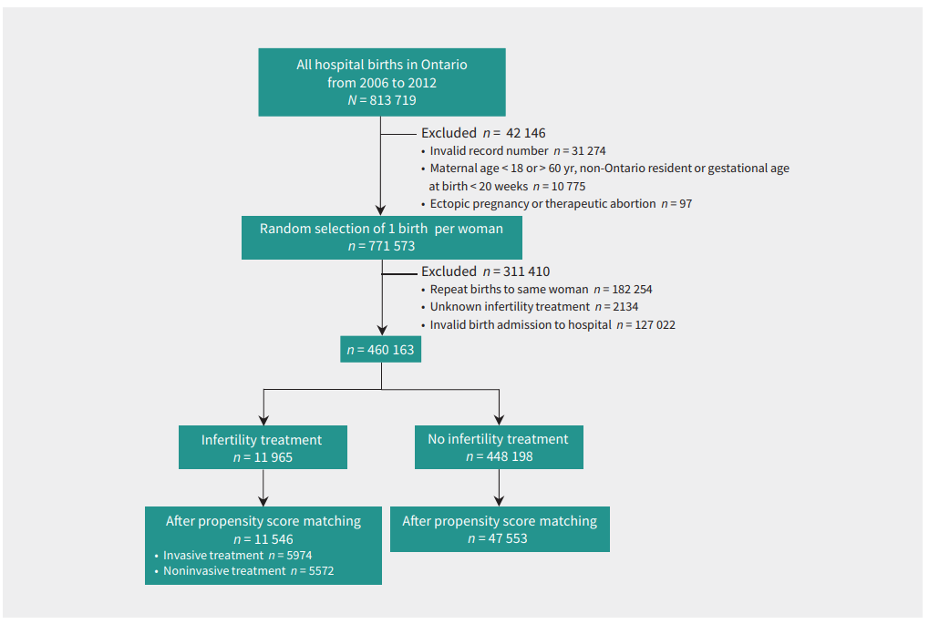
Matching combines well with regression!
Notes:
Discussion:
Helpful to have a discussion like this for how sample was constructed
Inclusion/exclusion criteria here are very clear.
Why might they randomly sample 1 birth per woman? (honestly, this isn’t well-justified to me).
Look at sample sizes before/after matching. What’s happening? We’re throwing away data that don’t match well!

Slide 60
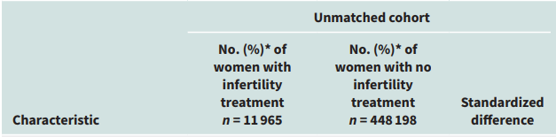
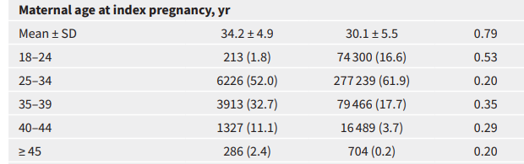

Why do we need matching?
Notes:
Balance tables! Look at the parentheses here first, they are the percentages rather than the raw counts. How do we interpret these?

Slide 61
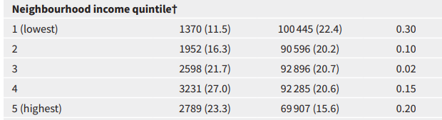
Why do we need matching?
Notes:
Balance tables! Look at the parentheses here first, they are the percentages rather than the raw counts. How do we interpret these?

Slide 62
So what does matching do?
Main matching algorithm
We want to match treated observations to similar control observations
What will our matching criteria be? (what is “similar”?)
Are we assigning matches or weights?
How many matches will we select?
How will weights decay with distance?
What is the worst acceptable match?
Notes:
Preprocessing should be informed by the causal model you have in mind (you guess something about what is non-random in treatment assignment and fix it)

Slide 63
Approximate Matching: Nearest Neighbor
When exact matches aren’t possible, rely on collection of neighbors
What does it mean to be a neighbor with multiple variables?
Notes:
This is the way most matching actually happens these days!

Slide 64
Approximate Matching: Nearest Neighbor
When exact matches aren’t possible, rely on collection of neighbors
What does it mean to be a neighbor with multiple variables?
Need a measure of distance across multiple variables:
$$\left|\left|X_{i}−X_{j}\right|\right|=\sqrt{\sum_{n=1}^{k}{\frac{{\left(X_{ni}−X_{nj}\right)}^{2}}{σ_{n}^{2}}}}$$
Squared distance in variables
Scaled by variance – units of measurement matter!
Multiple other options for distance!
Notes:
Subscript notes: I and j are people, n is covariate (age, sex, bmi, married, etc.)

Slide 65
Approximate Matching: Nearest Neighbor
When exact matches aren’t possible, rely on collection of neighbors
What does it mean to be a neighbor with multiple variables?
Need a measure of distance across multiple variables:
$$\left|\left|X_{i}−X_{j}\right|\right|=\sqrt{\sum_{n=1}^{k}{\frac{{\left(X_{ni}−X_{nj}\right)}^{2}}{σ_{n}^{2}}}}$$
Squared distance in variables
Scaled by variance – units of measurement matter!
Multiple other options for distance!
Based on distance, 1 observation can be matched to K best approximations
Notes:
You have to choose k

Slide 66
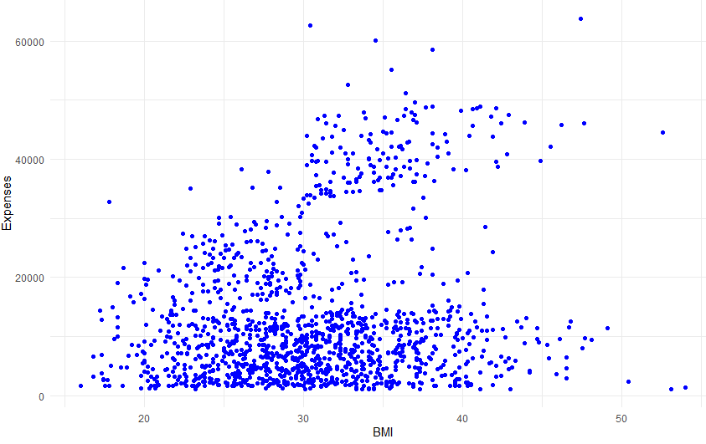
Nearest Neighbor Matching

Slide 67
Nearest Neighbor Matching
Notes:
So what are the neighbors of this guy?

Slide 68
Nearest Neighbor Matching
Notes:
How do we choose k?

Slide 69
Nearest Neighbor Matching

Slide 70
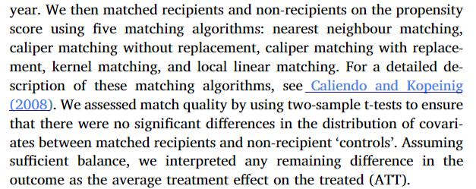
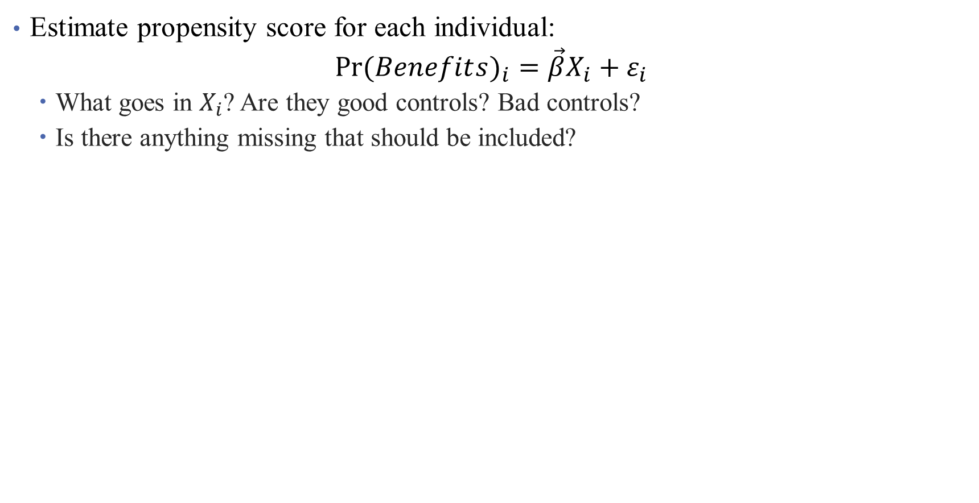
Nearest Neighbor Matching in Practice
Estimate propensity score for each individual:
$$Pr⁡(Benefit{s)}_{i}=\vec{β}X_{i}+ε_{i}$$
What goes in $X_{i}$? Are they good controls? Bad controls?
Is there anything missing that should be included?
Match size of k neighbors
How were neighbors defined? Predicted Propensity score
How are the propensity scores used?
Closest propensity scores within the “caliper”
Matching without replacement
Notes:
Will need to update this slide.

Slide 71
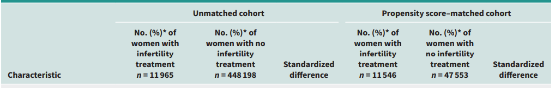
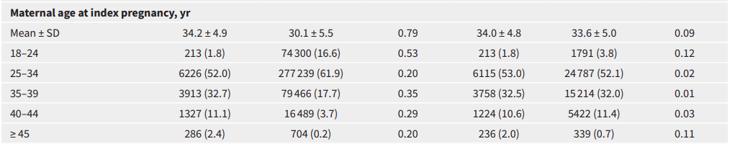
What happens after we match?
Notes:
Balance tables! Look at the parentheses here first, they are the percentages rather than the raw counts. How do we interpret these? How do we decide if the match is good enough?

Slide 72
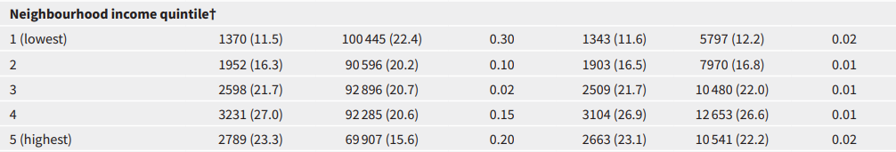
What happens after we match?
Notes:
This looks better, at least. So the matching may have been more helpful in some areas than others (how do we decide what that means)?

Slide 73
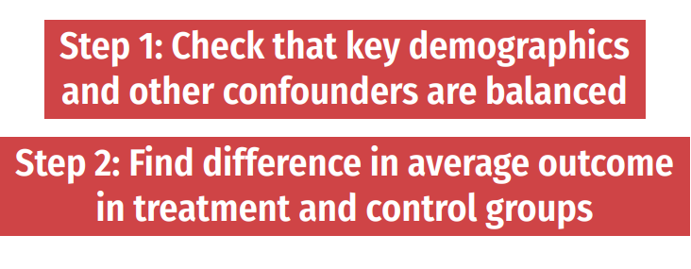
Analyzing a (truly) random experiment
If your treatment is truly randomized, analysis is easy!
Notes:
So if you are analyzing data from an RCT, you really just have to look at differences in means (maybe adjusting the SE s or adjusting for multiple hypothesis testing). You don’t even need controls! (Why? No confounding) Our goal today: can we simulate an RCT in the real world? (You can add adjustment if you need to).

Slide 74
Step 2: Estimation
The matched sample becomes our new analytical sample
Once we establish balance, we can mimic the analysis of an RCT!
Calculate difference in means, potentially with regression adjustment
Notes:
Here, what is the regression? What is the main coefficient of interest?

Slide 75
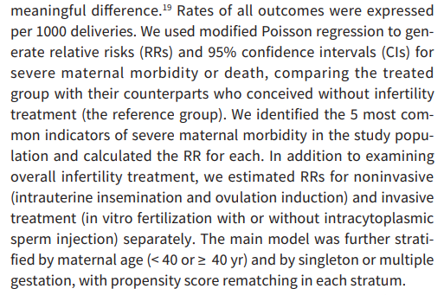
Step 2: Estimation
The matched sample becomes our new analytical sample
Once we establish balance, we can mimic the analysis of an RCT!
Calculate difference in means, potentially with regression adjustment
Notes:
Here, what is the regression? What is the main coefficient of interest? Did they have any controls (no)? What did they do instead (lots of subgroup analysis)?

Slide 76

Results
Notes:
Difference in means + regression + nice visualization (ish). What do we think? What works well? What doesn’t?

Slide 77

Results
Notes:
Zoom out view.

Slide 78
How is this different than controlling in OLS?
Intuitively, differences lie in how we deal with backdoor paths:
Regression removes all variation in $X→Y$ associated with variation in $W$
Matching chooses a sample in which there is no variation in $W$

Slide 79

How is this different than controlling in OLS?
Intuitively, differences lie in how we deal with backdoor paths:
Regression removes all variation in $X→Y$ associated with variation in $W$
Matching chooses a sample in which there is no variation in $W$
Pros and cons of matching (Black 2015)
Notes:
Also note that the OLS assigns weights to observations that may bias your estimate of ATE or ATT, particularly if (1) probability of treatment varies with x and (2) E(Y_1-Y_0|x) varies in x

Slide 80
Some Matching Best Practices
Show balance after matching (balance table)
Check if observations with similar propensity scores are balanced (stratification tests)
Show common support is valid in your setting

Slide 81
Some Matching Best Practices
Show balance after matching (balance table)
Check if observations with similar propensity scores are balanced (stratification tests)
Show common support is valid in your setting
Propensity scores close to 0 or 1 give large weights – trim data set
Try (and report) multiple bandwidths/approaches/replacement
You will need to argue CIA holds convincingly
Some more tips: blogs.worldbank/what-do-you-need-do-make-matching-estimator-convincing

Slide 82
Other Caveats
Economists tend to be more (not totally!) skeptical of matching methods
Highly sensitive to both variables included and analysis sample used (Smith and Todd 2001, 2005)
Matching methods are also highly sensitive to omitted variable bias
We’re still shook from the PSM debaucle
You may be throwing away data and still left with biased estimates if imbalance remains
This is substantive of a larger critique: can we ever achieve the CIA with observational data?
Are we more worried about selection on observables? Or unobservables?
Notes:
If you can’t match on, say, ability, your matching might be making things worse.
PSM had its heyday, now we have problems with it.

Slide 83

Problems of Unobservables
Notes:
King Charles – added this before the coronation.

Slide 84
Problems of Unobservables

Slide 85
Interpretation and Limitations of Analysis
What worked well in this analysis?
What was lacking?
What are the takeaways for you?
What might limit the takeaways? What hinders your approach to thinking of this as causal?
Any other thoughts?
Notes:
I don’t think they did a super good job dealing with this. Their limitations are all “fake” limitations.

